Slide 1

Pivotal Cloud Foundary

Slide 2
Agenda
What is Cloud
What is CF
Key aspects of CF
CF Concepts
PCF Introduction
PCF Basics
PCF App Manager Console
PCF Services
CF CLI
Deployment
Scaling
VCAP services
Summary

Slide 3
What is Cloud
Cloud Foundry (CF) is an open source and has become the industry standard for deploying apps.
Cloud platforms let anyone deploy network apps or services and make them available to the world in a few minutes.
When an app becomes popular, the cloud easily scales it to handle more traffic.

Slide 4
Key aspects of PCF
Cloud platforms, enabling you to focus exclusively on your applications and data without worrying about underlying infrastructure.
Cloud native apps can be deployed on your own computing infrastructure or on any IaaS platform (AWS, Vsphere, etc ..)
Cloud Foundry is ideal for anyone interested in removing the cost and complexity of configuring infrastructure for their apps.
Developers can deploy their apps to Cloud Foundry using their existing tools and with zero modification to their code.
The platform’s openness and extensibility prevent its users from being locked into a single framework, set of app services, or cloud.

Slide 5
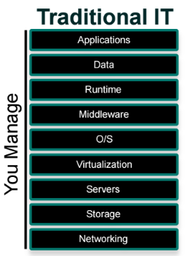
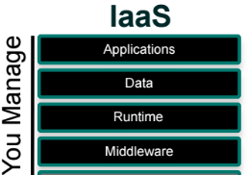

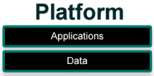
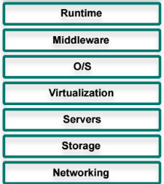

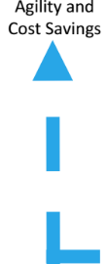
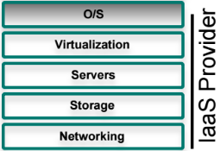
What is CF

Slide 6




CF Concepts
CF uses a role-based access control (RBAC) system to grant Cloud Foundry users permissions appropriate to their role within an org or a space.
User Accounts
A user account represents an individual person within the context of a CF installation. A user can have different roles in different spaces within an org, governing what level and type of access they have within that space.
Roles &
Permissions
A user can have one or more roles. The combination of these roles defines the user’s overall permissions in the org and within specific spaces in that org.
Orgs
An org is a development account that an individual or multiple collaborators can own and use. All collaborators access an org with user accounts. Collaborators in an org share a resource quota plan, applications, services availability, and custom domains.
Spaces
Every application and service is scoped to a space. Each org contains at least one space. A space provides users with access to a shared location for application development, deployment, and maintenance.

Slide 7
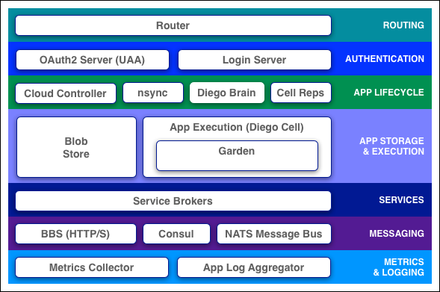
Cloud Foundry Components

Slide 8
Routing
Router intercepts the incoming traffic request, it will try to map to routing table that it updates periodically from BBS (Bulletin Board system)
So after finding a match to the incoming traffic request from the table it decides to route to corresponding component [ i.e either to cloud controller or to the Diego cell running that particular application]
Recomputation for updating its routing table is performed by considering the IP address of each cell VM and the host side PORT number of the container in that cell.

Slide 9

Routing
Cloud controller
Diego cell
Garden
Router
HTTP
Req
returns match route
lookup
BBS
Routing Table
updates periodically

Slide 10
Authentication
OAuth2 Server (UAA) and Login Server
The OAuth2 server (UAA) and Login Server work together to provide identity management.

Slide 11
App Lifecycle - Cloud Controller and Diego Brain
Cloud controller and Diego brain are part of an “automation engine for application deployment and lifecycle management”.
Cloud controller directs Diego brain through CC-Bridge to coordinate each Diego Cells to stage and run the applications.

Slide 12
App Lifecycle - Cloud Controller and Diego Brain
Cloud controller
Cloud Controller exposed as REST API endpoints. Clients should use the REST API endpoints for various operations that the cloud controller handles.
Cloud controller internally maintains a DB which has various tables, such as orgs, spaces, services, user roles and more..
The Cloud Controller uses the Diego Auction balance application processes over the cells in a Cloud Foundry installation.

Slide 13
App Lifecycle - Cloud Controller and Diego Brain
Diego Auction
Diego Auction algorithm determines which VM should be used to run the new process.
The auction algorithm balances the load on VMs and optimizes application availability and resilience.
There are various steps that it follows;
Tasks and Long-Running Processes
Ordering the Auction Batch
Auctioning the Batch to the Cells
Triggering Another Auction

Slide 14
App Lifecycle - Cloud Controller and Diego Brain
Diego Auction – Task and Long running process
It classifies jobs into two types : Tasks and Long-Running Processes(LRPs).
Tasks run once, for a finite amount of time.
LRPs run continuously, for an indefinite amount of time.
LRPs terminate only if stopped or killed, or if they crash. Examples include web servers, asynchronous background workers, and other applications and services that continuously accept and process input.
Diego Auction process repeats whenever new jobs need to be allocated to VMs.
Auction will distribute the batch work. This includes:
newly-created jobs,
jobs left unallocated in the previous auction,
and jobs left orphaned by failed VMs.
Only one auction can take place at a time, which prevents placement collisions
Notes:
Task - A common example is a staging task that compiles an app’s dependencies, to form a self-contained droplet that makes the app portable and runnable on multiple VMs. Other examples of tasks include making a database schema change, bulk importing data to initialize a database, and setting up a connected service.
LRPs - To make high-demand LRPs more available, Diego may allocate multiple instances of the same application to run simultaneously on different VMs, often spread across Availability Zones that serve users in different geographic regions.

Slide 15
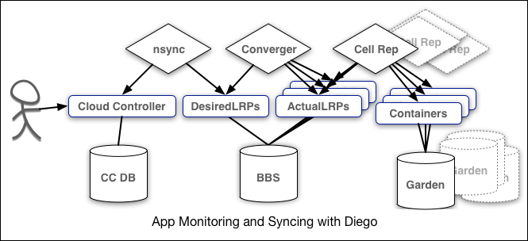
App Lifecycle - nsync, BBS, and Cell Reps
The nsync, BBS, and Cell Reps use a more distributed approach.
For High availablity, cloud deployments must constantly monitor their states and reconcile them with their expected states such as starting and stopping processes as required.
nsync - receives a message from the Cloud Controller when the user scales an app. It writes the number of instances into a DesiredLRP structure in the Diego BBS database.
BBS - uses its convergence process to monitor the DesiredLRP and ActualLRP values. It launches or kills application instances as appropriate to ensure the ActualLRP count matches the DesiredLRP count.
Cell Rep - monitors the containers and provides the ActualLRP value.

Slide 16
App Storage and Execution
Blobstore
The blobstore is a repository for large binary files. Blobstore binaries include:
Application code packages
Buildpacks
Droplets
Either an internal server or an external S3 or S3-compatible endpoint can be configured as the blobstore.
Diego Cell
Each application VM has a Diego Cell that executes application start and stop actions locally, manages the VM’s containers, and reports app status and other data to the BBS and Loggregator

Slide 17
Messaging
Consul and BBS
Cloud Foundry component VMs communicate with each other internally through HTTP and HTTPS protocols, sharing temporary messages and data stored in two locations:
A Consul server stores longer-lived control data, such as component IP addresses and distributed locks that prevent components from duplicating actions.
Diego’s Bulletin Board System (BBS) stores more frequently updated and disposable data such as cell and application status, unallocated work, and heartbeat messages. The BBS stores data in MySQL, using the Go MySQL Driver.
The route-emitter component uses the NATS protocol to broadcast the latest routing tables to the routers. In pre-Diego CF architecture, the NATS Message Bus carried all internal component communications.

Slide 18
CF CLI commands
Cloud Foundry Command Line Interface (cf CLI), a tool you use to deploy and manage your applications.
Use cf config to set the language. To set the language with cf config, use the syntax:
E.g.
cf config --locale YOUR_LANGUAGE
Use cf login to log in to Elastic Runtime.
E.g.
cf login [-a API_URL] [-u USERNAME] [-p PASSWORD] [-o ORG] [-s SPACE]
Commands for Listing Users:
E.g.
cf org-users
cf space-users
Commands for Managing Roles
E.g.
cf set-org-role (cf set-org-role huey@example.com example-org OrgManager)
cf unset-org-role
cf set-space-role
cf unset-space-role

Slide 19
Commands – CF CLI
The cf push command pushes a new app or syncs changes to an existing app.
Creating app my-awesome-app in org example-org
E.g. cf push my-awesome-app -b https://github.com/cloudfoundry/java-buildpack.git
To view available services from the PCF market place, use
E.g. cf marketplace
The cf help command lists the cf CLI commands and a brief description of each.
E.g. cf delete –h
User-Provided Service Instances
Use (alias cf cups) creates a new service instance.
E.g. cf cups sql-service-instance -p "host, port, dbname, username, password“
To create a service instance that sends data to a third-party.
Use the -l option followed by the external destination URL.
E.g. cf cups mylog -l syslog://logs4.example.com:25258
Use (alias cf uups) to update a existing service instance.
E.g. cf uups sql-service-instance -p "host, port, dbname, username, password“

Slide 20
App Deployment
Deployment Process
CF Push command to be used to push an cloud-native app into PCF.
Before you can push your app to Cloud Foundry you need to know:
The API endpoint for your Cloud Foundry instance. Also known as the target URL, this is the URL of the Cloud Controller in your Cloud Foundry instance.
Your username and password for your Cloud Foundry instance.
The organization and space where you want to deploy your app. A Cloud Foundry workspace is organized into organizations, and within them, spaces. As a Cloud Foundry user, you have access to one or more organizations and spaces.
Deploy an app to PCF by running a cf push command from the Cloud Foundry Command Line Interface (cf CLI). The command does few operation at the background:
Uploads and stores app files
Examines and stores app metadata
Creates a “droplet” (the Cloud Foundry unit of execution) for the app
Selects an appropriate Diego cell or Droplet Execution Agent (DEA) to run the droplet
Starts the app

Slide 21
App Deployment
Deployment Options
Name: as the name of your app.
Instances: Generally speaking, the more instances you run, the less downtime your app will experience.
Memory Limit: The maximum amount of memory that each instance of your app can consume. If an instance exceeds this limit, Cloud Foundry restarts the instance.
Start Command: This is the command that Cloud Foundry uses to start each instance of your app. This start command varies by app framework.
Subdomain (host) and Domain: The route, which is the combination of subdomain and domain, must be globally unique. This is true whether you specify a portion of the route or allow Cloud Foundry to use defaults.
Services: Apps can bind to services such as databases, messaging, and key-value stores. Apps are deployed into app spaces. An app can only bind to a service that has an existing instance in the target app space.
Notes:
Note: Initially, Cloud Foundry immediately restarts any instances that exceed the memory limit. If an instance repeatedly exceeds the memory limit in a short period of time, Cloud Foundry delays restarting the instance.

Slide 22
App Deployment
Configure Pre-Runtime Hook
Java build pack does not support pre-runtime hooks.
To configure pre-runtime hooks, create a file named .profile and place it in the root of your app directory. If the directory includes a .profile script, then Cloud Foundry executes it immediately before each instance of your app starts.
You can use the .profile script to perform app-specific initialization tasks, such as setting custom environment variables. Environment variables are key-value pairs.
To set an environment variable, add the appropriate bash commands to your .profile file. See the example below.
# Set the default LANG for your apps
export LANG=en_US.UTF-8
Notes:
Note: Your app root directory may also include a .profile.d directory that contains bash scripts that perform initialization tasks for the buildpack. Developers should not edit these scripts unless they are using a custom buildpack.

Slide 23
Blue-Green Deployment
Blue-green deployment is a release technique that reduces downtime and risk by running two identical production environments called Blue and Green.
At any time, only one of the environments is live, with the live environment serving all production traffic. For this example, Blue is currently live and Green is idle.
Notes:
If your app uses a relational database, blue-green deployment can lead to discrepancies between your Green and Blue databases during an update. To maximize data integrity, configure a single database for backward and forward compatibility.
You can adjust the route mapping pattern to display a static maintenance page during a maintenance window for time-consuming tasks, such as migrating a database. In this scenario, the router switches all incoming requests from Blue to Maintenance to Green.

Slide 24
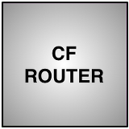


Blue-Green Deployment
Running Live in Prod.
To be deployed in Prod.
Notes:
If your app uses a relational database, blue-green deployment can lead to discrepancies between your Green and Blue databases during an update. To maximize data integrity, configure a single database for backward and forward compatibility.
You can adjust the route mapping pattern to display a static maintenance page during a maintenance window for time-consuming tasks, such as migrating a database. In this scenario, the router switches all incoming requests from Blue to Maintenance to Green.

Slide 25
Blue-Green Deployment
Green deployed app will start to Run Live in Prod.
Notes:
If your app uses a relational database, blue-green deployment can lead to discrepancies between your Green and Blue databases during an update. To maximize data integrity, configure a single database for backward and forward compatibility.
You can adjust the route mapping pattern to display a static maintenance page during a maintenance window for time-consuming tasks, such as migrating a database. In this scenario, the router switches all incoming requests from Blue to Maintenance to Green.

Slide 26
Scaling an Application
Factors such as user load, or the number and nature of tasks performed by an application, can change the disk space and memory the application uses. For many applications, increasing the available disk space or memory can improve overall performance
Scaling :
Running additional instances of an application can allow the application to handle increases in user load and concurrent requests..
Scaling Horizontally
cf scale myApp -i 5
Scaling Vertically
cf scale myApp -k 512M
cf scale myApp -m 1G

Slide 27
Services
For end users of Cloud Foundry they can do provisioning of service instances and integrating them with applications that have been pushed to Cloud Foundry.
Services and Service Instances
Cloud Foundry offers a marketplace of services, from which users can provision reserved resources on-demand.
E.g. resources services provide include databases on a shared or dedicated server, or accounts on a SaaS application.
These resources are known as service instances and the systems that deliver and operate these resources are known as Services.
User-Provided Service Instances
Cloud Foundry enables users to leverage services that are not available in the marketplace using a feature called User-Provided Service Instances (UPSI).
Service Instance Credentials
If your app need to bind or use any service instance, then user must use the credentials provided by CF.
For external and local clients, you can use service keys to generate credentials to communicate directly with a service instance
Notes:
For a service to be available in the marketplace, it must be integrated with Cloud Foundry by way of APIs.

Slide 28
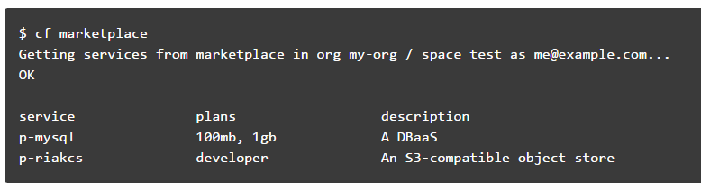
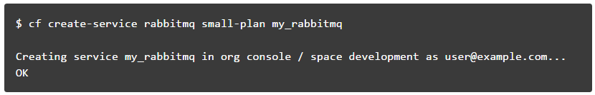
Manage Service Instances with the CLI
List Marketplace Services
Creating Service Instances
create a service instance with the command;
cf create-service <SERVICE> <PLAN> <SERVICE_INSTANCE>
Notes:
For a service to be available in the marketplace, it must be integrated with Cloud Foundry by way of APIs.

Slide 29
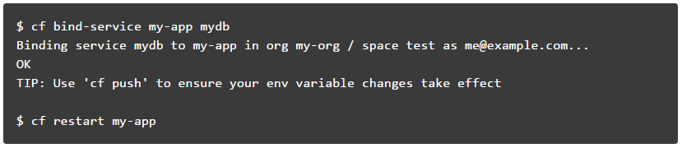
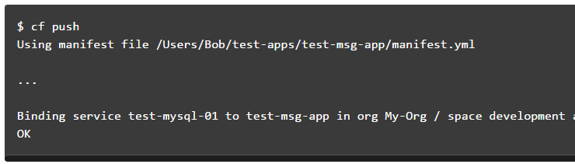
Manage Service Instances with the CLI
Bind a Service Instance
binding a service instance to an application after pushing an application
Binding with Application Manifest
Alternatively, a service instance can be bind to an app after pushing an application, you can use the application manifest to bind the service instance during push
Manifest.yml
services:
- test-mysql-01

Slide 30
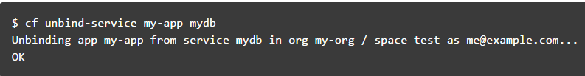
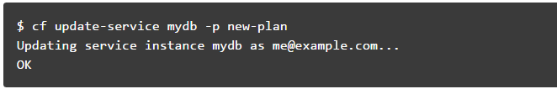
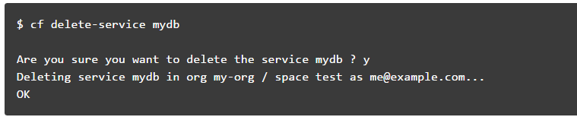
Manage Service Instances with the CLI
Unbind a Service Instance
Unbinding a service instance from an application removes the credentials created for your application from the VCAP_SERVICES environment variable.
Update a Service Instance
If any service plan needs to be updated to your service instance, then cf update-service can be performed,
Delete a service Instance
Notes:
Note: You must restart or in some cases re-push your application for changes to be applied to the VCAP_SERVICES environment variable and for the application to recognize these changes.

Slide 31
Buildpack
Buildpacks provide framework and runtime support for your applications.
Buildpacks typically examine user-provided artifacts to determine what dependencies to download and how to configure applications to communicate with bound services.
When you push an application, Cloud Foundry automatically detects which buildpack is required and installs it on the Diego cell or Droplet Execution Agent (DEA) where the application runs.
During staging, each buildpack has a position in a priority list (identified by running cf buildpacks).
Cloud Foundry checks if the buildpack in position 1 is a compatible buildpack. If the position 1 buildpack is not compatible, Cloud Foundry moves on to the buildpack in position 2. Cloud Foundry continues this process until the correct buildpack is found. If no buildpack is compatible cf push fails..

Slide 32
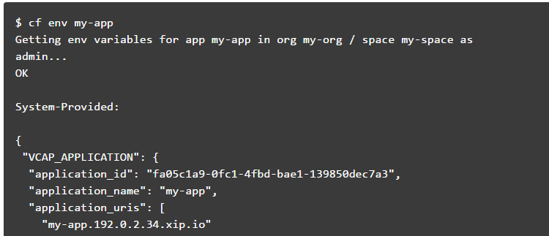
Cloud Foundry Environment Variables
Environment variables are the means by which the Cloud Foundry runtime communicates with a deployed application about its environment.
View Environment Variables

Slide 33
Example-
Deploy the Service Broker to Cloud Foundry
The service broker is configured via environment variables, which are defined in the manifest.yml file. Make the necessary changes to the MongoDB config in order to connect to your Mongo instance.
Push the service broker as an app to Cloud Foundry: cf push
Register the service broker using the default username and the password obtained from the previous step: cf csb mongodb admin admin http://mongodb-service-broker.local.pcfdev.io
Enable access to the service broker: cf enable-service-access mongodb
Create a service instance: cf cs mongodb default mymongodb

Slide 34
Cloud Foundry Environment Variables
VCAP_SERVICES
The VCAP_SERVICES environment variable is a JSON object that contains information that you can use to interact with a service instance
The information includes service instance name, credential, and connection URL to the service instance. These values are populated into the VCAP_SERVICES environment variable when your application is bound to a service instance.
The value of the VCAP_SERVICES environment variable is available only when you bind a service instance to your application.
The service object contains a child object for each service instance of that service that is bound to the application.

Slide 35
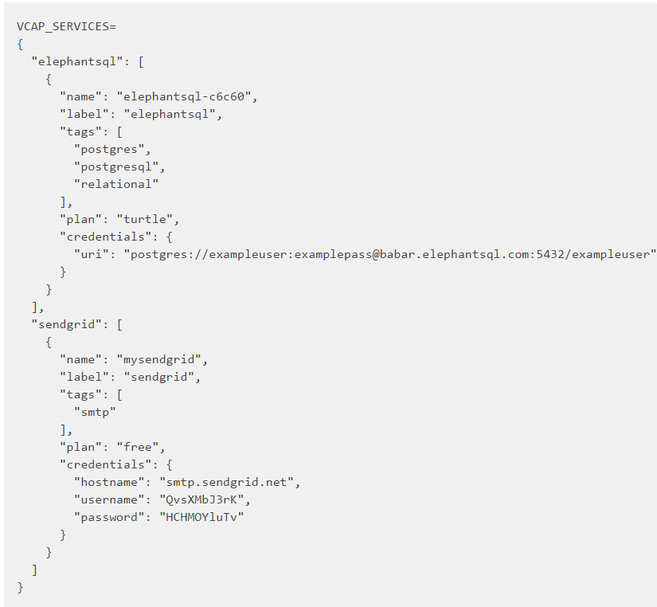
Cloud Foundry Environment Variables
VCAP_SERVICES
The example below shows the value of VCAP_SERVICES for bound instances of several services available in the Pivotal Web Services Marketplace.

Slide 36
